Slide 1
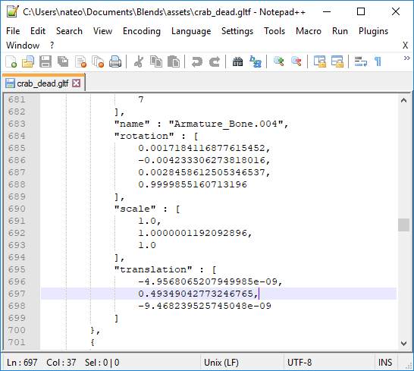
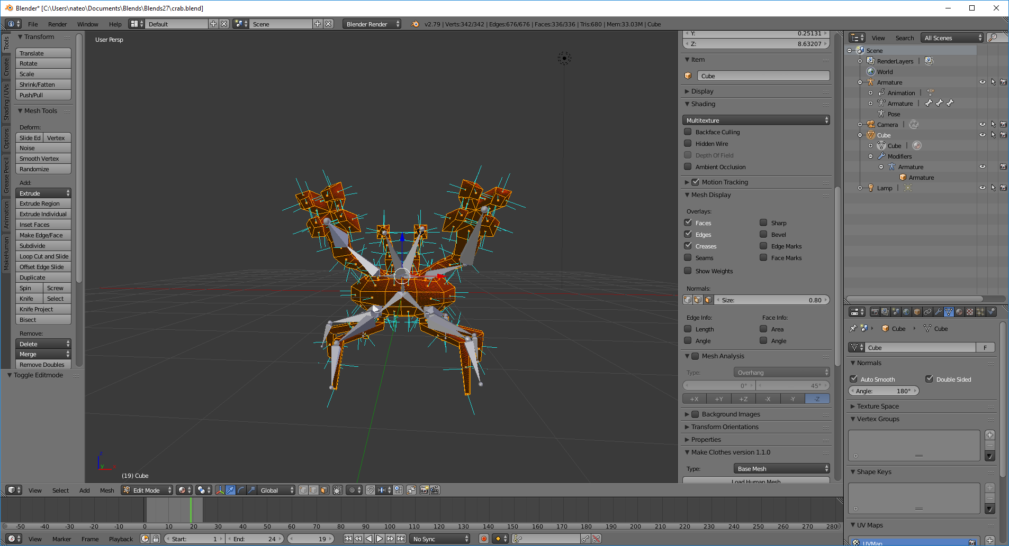
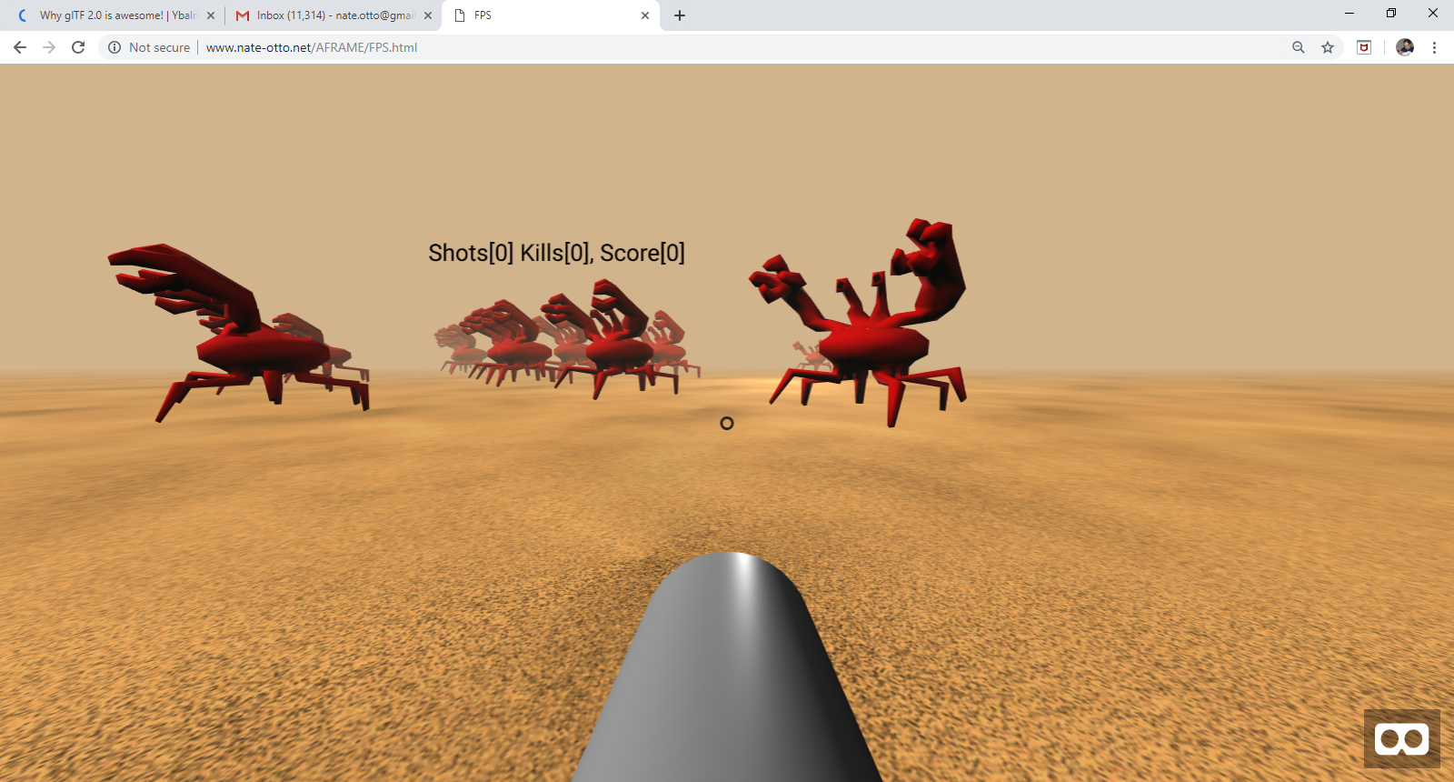
The glTF Modelling Format
“The JPEG of 3D Modelling Formats”

Slide 2
The glTF Format
What is a 3D Model?
Why glTF?
Let’s do something weird.
Where you can learn more.

Slide 3
The glTF Format
So what makes me think I’m qualified to talk about 3D Modelling formats?
Full-stack ASP.NET and C# Developer at UnitedHealth Group since 2013
Three semesters of adjunct teaching at CVTC
18 years’ experience in front-end web development
Self-taught (I didn’t know what a pointer was until 2014 … )
10 years’ experience 3D modelling
Played with QBasic in middle school

Slide 4
The glTF Format
What’s in this presentation for me?
Takeaways:
Find out whether 3D modelling is interesting enough to investigate further
If it is, know the best modelling format and get a feeling for how it’s done

Slide 5
The glTF Format
A 3D Model is made of …
Meshes
Materials
Animations
You create and view 3D models in …
Editors
Rendering software

Slide 6
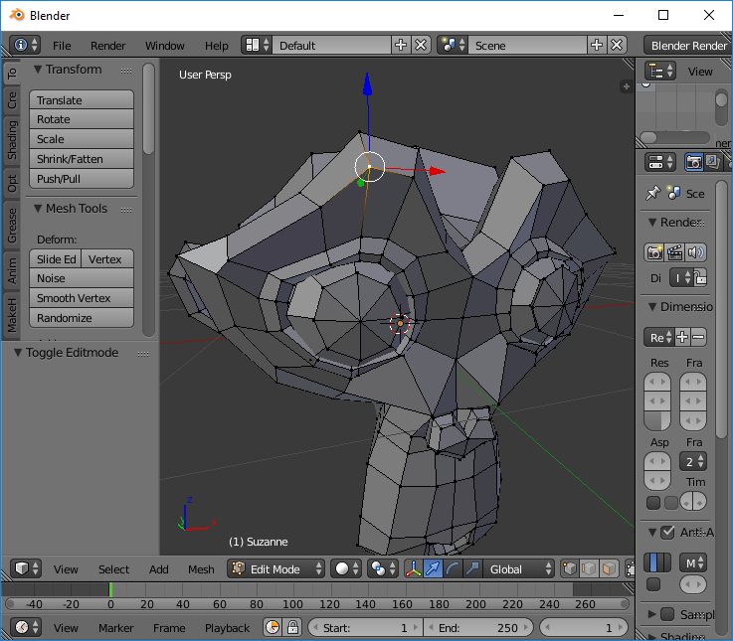
The glTF Format
The Mesh
Vertices
Lines
Faces

Slide 7
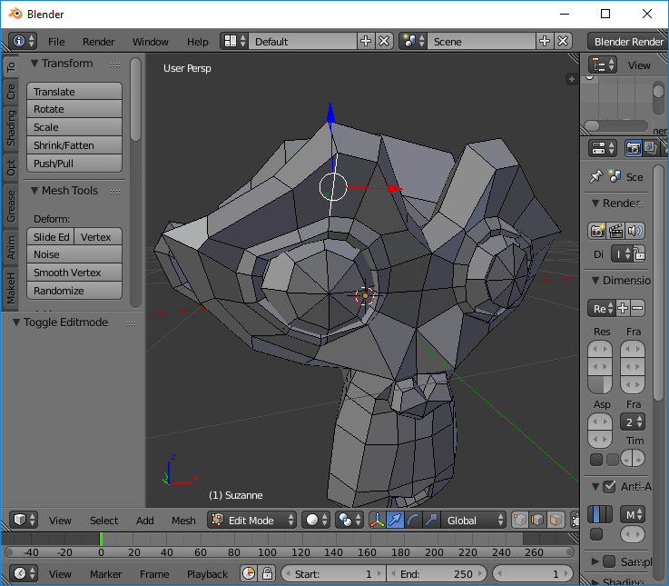
The glTF Format
The Mesh
Vertices
Lines
Faces

Slide 8
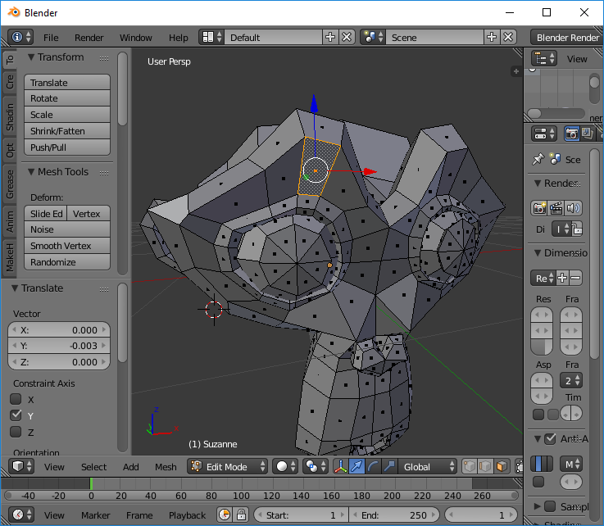
The glTF Format
The Mesh
Vertices
Lines
Faces

Slide 9
The glTF Format
Materials
Shading
Textures
UV Mapping

Slide 10
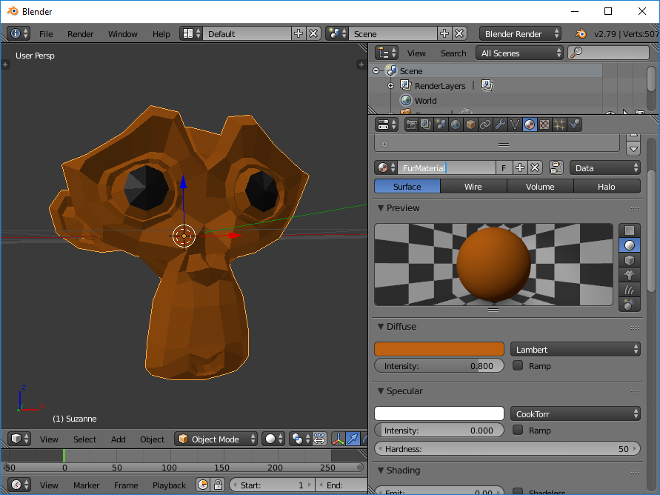
The glTF Format
Materials
Shading
Textures
UV Mapping
Edit vs. Render

Slide 11
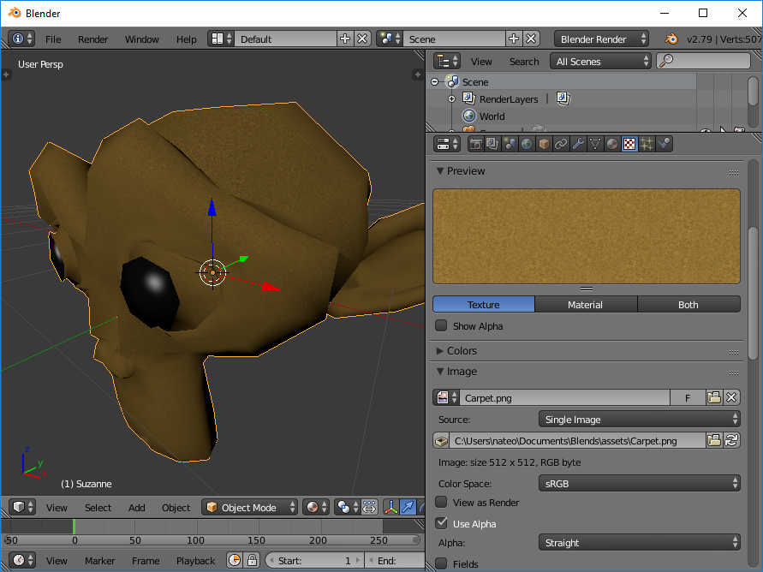
The glTF Format
Materials
Shading
Textures
UV Mapping
Edit vs. Render

Slide 12
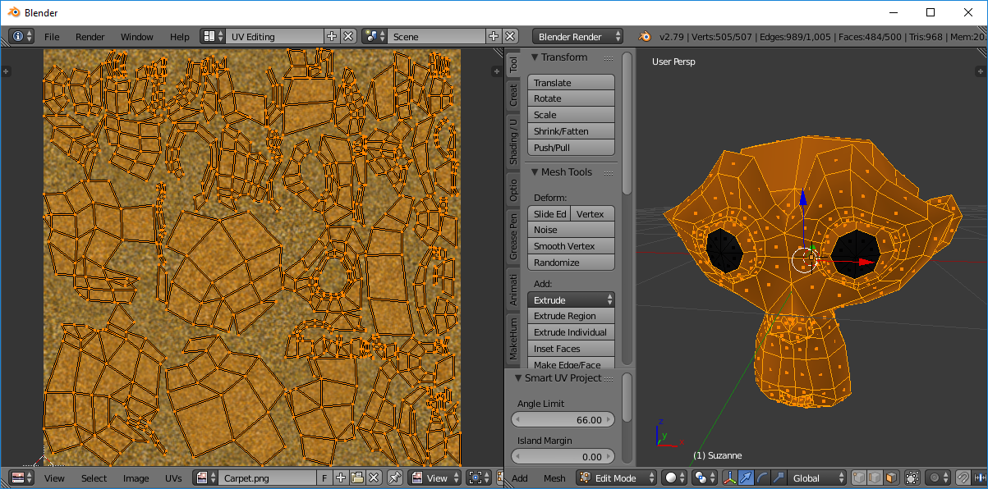
The glTF Format
Materials
Shading
Textures
UV Mapping
Edit vs. Render

Slide 13
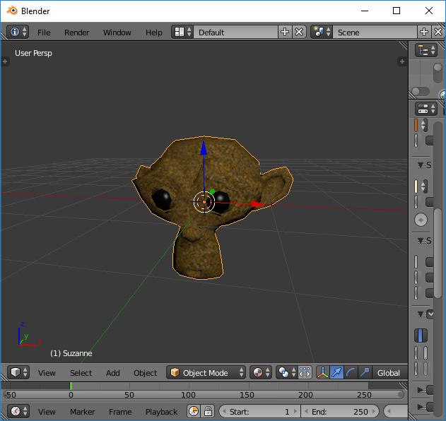
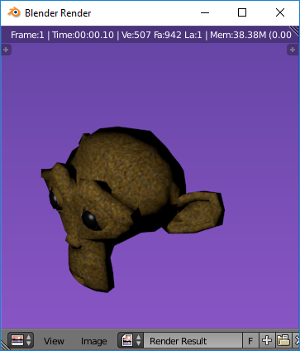
The glTF Format
Materials
Shading
Textures
UV Mapping
Edit vs. Render

Slide 14
The glTF Format
Animation
Bones
Shape keys
Wait … What is a key?
Dynamic manipulation

Slide 15
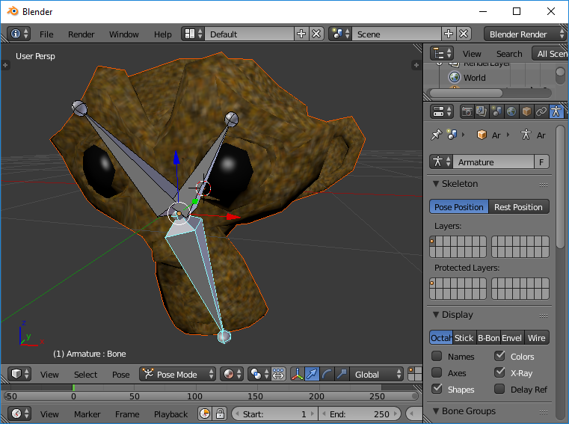
The glTF Format
Animation
Bones
Shape keys
Wait … What is a key?
Dynamic manipulation

Slide 16
The glTF Format
Animation
Bones
Shape keys
Wait … What is a key?
Dynamic manipulation
Deform your mesh. Save that deformation.
Deform again. Save that deformation under a different name.
Call each deformation to appear at set time.

Slide 17
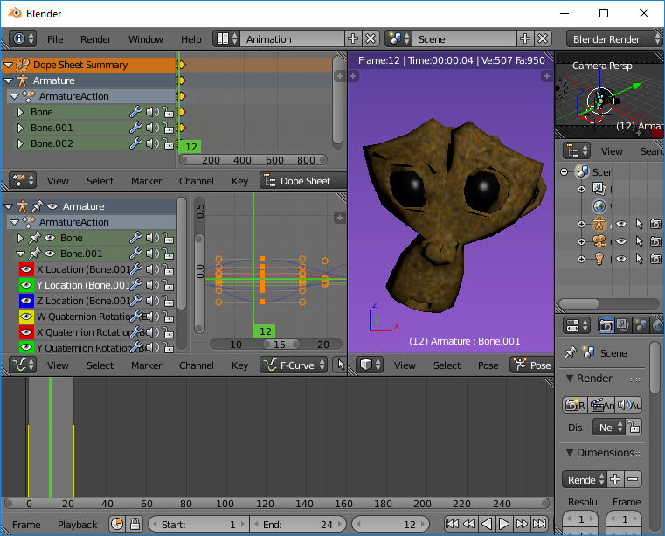
The glTF Format
Animation
Bones
Shape keys
Wait … What is a key?
Dynamic manipulation

Slide 18
The glTF Format
Animation
Bones
Shape keys
Wait … What is a key?
Dynamic manipulation

Slide 19
The glTF Format
What can I use to make models? **
Software | Price | Pros | Cons | You’ve seen it used in
3Ds Max or Maya | $$$$$ | Industry Standard. | Expensive | Everything from “Moana” to a Taco Bell commercial to Grand Theft Auto: Vice City
SketchUp | $$$ | Easy to use. Quick prototyping. | Proprietary issues: Is it your model? Limited animation. | Architectural visualizations.
Blender | Free | About as good as Maya and 3Ds Max. Huge user community. What you make is yours. | Difficult to learn. | “The Man in the High Castle” More and more movies. More video game assets.
** The information in this table is HIGHLY biased and poorly researched. I think I’m right about it, anyway.

Slide 20
The glTF Format
What can I use to view or interact with these models? **
Software | Price | Pros | Cons | You’ve seen it used in
Unity and Unreal | Free, but … | Industry Standard Huge user communities. Easy to learn. | Not for small projects and low-end computers. | Everywhere. Especially Unity. Especially in phone apps.
Maya, 3DS Max, Blender, SketchUp | Free to $$$$$ | Industry Standard | For movies, not for interactivity. Blender had a game engine. | Animated films and special effects.
Godot | Free | Great interface. Easy to learn. Growing community. | Smaller community. Unique way of doing things (lots of nodes). | I haven’t. Have you?
Three.js libraries | Mostly free | You have total control. | You have total control. | Menards infographics. Anything 3D on the web.
A-Frame.io | Free | Easy to use. Leading WebVR platform. Builds on Three.js | Limited pre-built assets. | WebVR demos, particularly architectural ones.
** If the table on the previous slide is biased and poorly researched, this table is worse.

Slide 21
The glTF Format
Why glTF?
Format | File Size | Supports Animation | Stored as | Dynamic at Run Time | Don’t use for … | Use for …
.obj | Small | No | Plain Text | No | Animated stuff. | Physics engines, static props.
.dae | Big | Yes | XML | Yes | Anything. | Nothing.
.fbx | Big | Yes | XML | Yes | Anything. | Unless Unity forces you.
.glTF | Small | Yes | JSON & Binary | Yes | Individual static assets | Everything else.

Slide 22
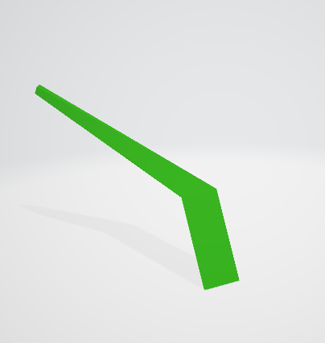
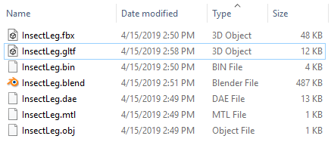
The glTF Format
Same model exported to different formats.
InsectLeg.blend is the file used to create and edit, so it is the biggest.
InsectLeg.obj is the smallest, but contains no animations.
InsectLeg.fbx is four times as big as InsectLeg.glTF, but has identical features.
My PC won’t recognize InsectLeg.dae.
InsectLeg.mtl is the materials file for InsectLeg.obj.
InsectLeg.bin is the binary for InsectLeg.glTF.

Slide 23
The glTF Format
More complex the model, the bigger the size difference.
5MB .dae/.glTF = 2.5MB glTF

Slide 24
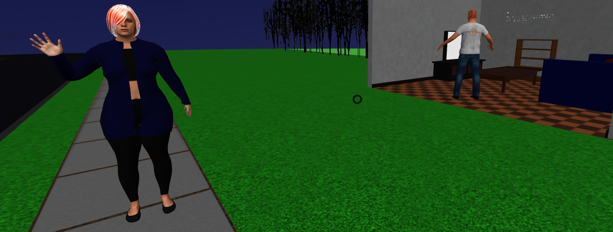
The glTF Format
How about we do something with this information.
Let’s find a file that has an example of a glTF animation.
(http://www.nate-otto.net/Demo/glTF_demo.html)
… and make it more interesting.

Slide 25
The glTF Format
For more information ….
Modelling Tools
www.blender.org
www.gimp.org (open-source alternative to PhotoShop)
www.makehumancommunity.org
glTF-Friendly Game Engines
www.aframe.io
www.three.js
Unity, Unreal, Godot
Learning Resources
Blender Guru

